Slide 1
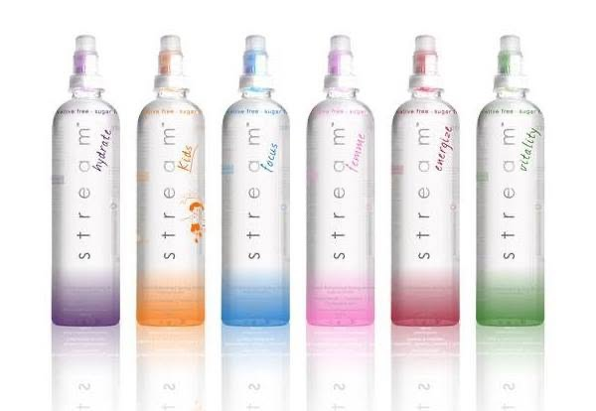
s t r e a m™
FUNCTIONAL HYDRATION. DELIVERED FRESH.
EQUITY ALLIANCE
VENTURE CAPITAL & ANGEL INVESTMENTS
FUNCTIONAL HYDRATION.
FRESH VITAMINS.
EVERY TIME.
Stream Drinks is a functional beverage platform built around a fresh-dose cap system: vitamins and functional ingredients are stored safely in the cap, then released into water at the moment of consumption.
Investor opportunity: a proven historical beverage asset, now ready for a disciplined modern relaunch.
Equity Alliance | Venture Capital & Angel Investments | Confidential investor draft
Notes:
[Sources] Cover and product image
User-uploaded product image: real Stream Drinks bottle range.
Deck positioning is a company draft; claims should be verified against current formulation, IP, regulatory and supplier documents before external fundraising.

Slide 2
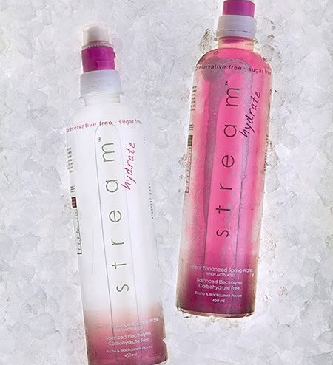
The investment thesis
A relaunch opportunity with evidence of past product-market resonance.
Stream is not a blank-page beverage idea. It has product heritage, retail proof, awards, press and an intuitive technological reason-to-believe.
Category tailwinds: consumers are increasingly choosing drinks by desired function — energy, focus, hydration, gut health, relaxation or social wellness.
Product edge: fresh-dose cap protects vitamins and functional ingredients until consumption.
VC angle: fund a disciplined reactivation, validate today’s economics, then scale with retail velocity and strategic optionality.
Equity Alliance | Venture Capital & Angel Investments | Confidential investor draft
Notes:
[Sources] Investment thesis
Axios reported functional beverage sales at $31.3B in the U.S. over the past year, up nearly 11% YoY and about 147% over four years, citing NielsenIQ: https://www.axios.com/local/austin/2026/08/07/mood-drinks-boom
User-uploaded Stream Drinks photos and archive support historical brand and product story; current commercial claims require verification.

Slide 3
The functional beverage market is expanding
Large category, fast-growing use cases, and strategic-buyer interest.
$149.8B
$248.5B
$31.3B
Global functional beverages market, 2024
Projected global market by 2030
U.S. functional beverage sales over past year
2024
149.8
4 yrs ago
100
2030
248.5
Now
147
Global category growth projection
Indexed U.S. category growth cited by Axios/NielsenIQ
The buyer is no longer just thirsty — they are buying a desired state.
Equity Alliance | Venture Capital & Angel Investments | Confidential investor draft
Notes:
[Sources] Market size and momentum
Vogue / Grand View Research cited global functional beverage market at $149.75B in 2024 and projected $248.5B by 2030: https://www.vogue.com/article/from-prebiotic-pepsi-to-ag1-inside-the-functional-drinks-boom
Axios / NielsenIQ: U.S. functional beverage sales $31.3B, +11% YoY and +147% over four years: https://www.axios.com/local/austin/2026/08/07/mood-drinks-boom

Slide 4
Fresh-dose cap technology
The problem with ordinary vitamin waters
Vitamins and sensitive nutraceuticals can degrade when pre-mixed in water, exposed to light and held on shelf.
Most drinks sell a health promise, but the consumer cannot see freshness or activation.
Stream makes the benefit visible: activate the cap, release the dose, shake and drink.
Protected
Fresh
Believable
Scalable
Functional dose kept separate from water until use.
Released at the moment of consumption.
A physical activation ritual supports the brand promise.
A platform across multiple functional SKUs.
Equity Alliance | Venture Capital & Angel Investments | Confidential investor draft
Notes:
[Sources] Fresh-dose technology
Bizcommunity article states Stream’s unique cap device houses ingredients safely away from the elements and delivers vitamins, plant nutrients and nutraceuticals into water once activated by the consumer: https://www.bizcommunity.com/Article/196/469/103089.html
User-provided explanation: vitamins are stored safely in the cap and released on consumption for maximum freshness. Product-specific stability tests should be attached in the final investor diligence pack.

Slide 5
A platform, not a single drink
Six historical functions create line-extension potential and retail shelf presence.
Hydrate
Kids
replenishment / electrolytes
family wellness
Focus
Femme
mental clarity
female wellness
Energize
Vitality
energy + activity
daily wellness
Relaunch discipline: start with the 1–2 most commercially obvious hero SKUs, then extend once repeat purchase and unit economics are proven.
Equity Alliance | Venture Capital & Angel Investments | Confidential investor draft
Notes:
[Sources] Range and product functions
Bizcommunity article lists Stream Energize, Femme, Focus, Hydrate, Vitality and Kids as the Stream range: https://www.bizcommunity.com/Article/196/469/103089.html
User-uploaded product range image shows the Stream bottle family.

Slide 6
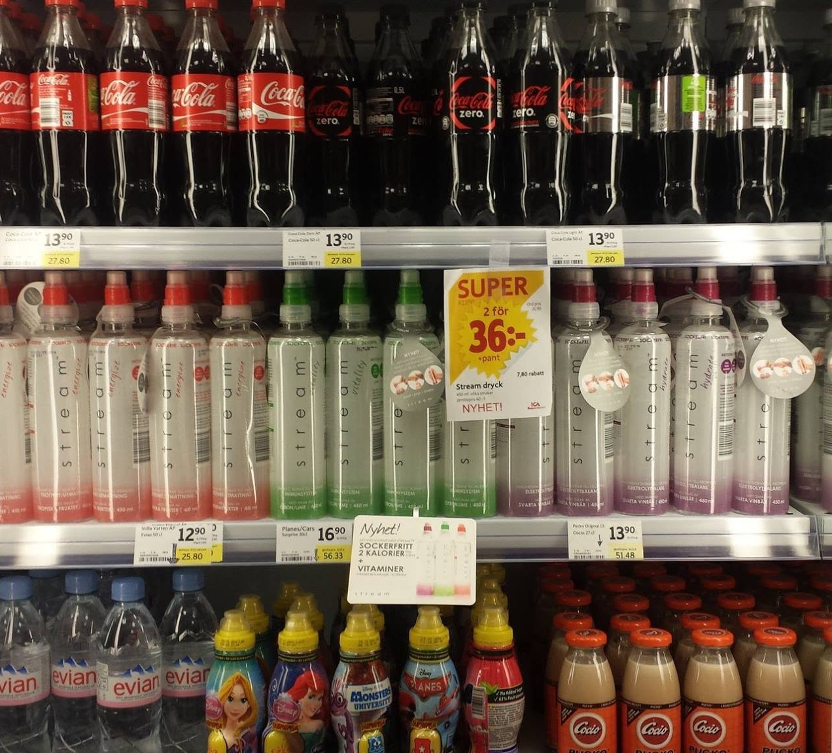
Historical proof: nationwide footprint
Stream previously moved beyond concept into real retail availability.
130+
100
locations across South Africa and Namibia announced in 2013
additional locations announced as rolling out
Flagship locations named included SPAR, ENGEN, Shell, Wakaberry, Pro Shop, Cycle Lab and Vida e Caffè.
Other channels included gyms, cafés and restaurants including SWEAT 1000 and Giovanni’s.
The shelf photo supports the historical retail proof story visually: Stream was on-shelf, tagged and promoted.
Equity Alliance | Venture Capital & Angel Investments | Confidential investor draft
Notes:
[Sources] Nationwide footprint and retail proof
Bizcommunity reported Stream was available at over 130 locations across South Africa and Namibia, with 100 more rolling out; named locations included SPAR, ENGEN, Shell, Wakaberry, Pro Shop, Cycle Lab, Vida e Caffè, SWEAT 1000 and Giovanni’s: https://www.bizcommunity.com/Article/196/469/103089.html
User-uploaded retail shelf image used as historical visual proof; exact store/date should be confirmed before external investor use.

Slide 7
Historical awards & credibility
Awards help investors understand that the proposition once stood out.
Food Review / Symrise
InnoBev Global Beverage Summit
First place in 2011 New Product Competition; runners-up included notable national/emerging brands.
Six awards at the 2011 Beverage Innovation Functional Drinks Awards.
London IFE
2013 validation
Fresh Idea Award + Show Case Award at the UK food & drink trade expo.
Second runner-up by Food Review/Symrise and Product of the Month by top-rated SPAR.
Important investor framing: these are historical credibility signals — not current revenue claims.
Equity Alliance | Venture Capital & Angel Investments | Confidential investor draft
Notes:
[Sources] Awards and credibility
Bizcommunity article lists Stream awards including Food Review/Symrise New Product Competition, InnoBev Global Beverage Summit, London IFE Fresh Idea Award and Show Case Award, and Product of the Month by a top-rated SPAR: https://www.bizcommunity.com/Article/196/469/103089.html

Slide 8
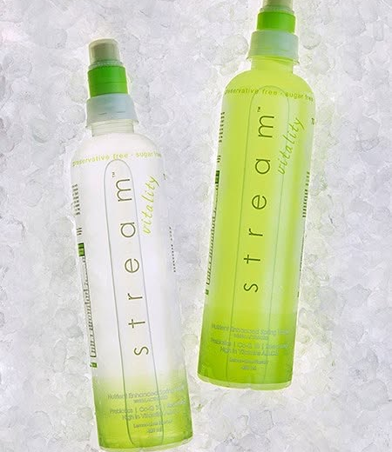
Brand memory: culture, athletes, media
Historical archive points to more than product — Stream had social energy.
Sweden / EEC launch
Official launch in Sweden with prime shelf space at large retailers.
Athletes + creators
Archive references kiteboarding champion Bas Koole, Swedish Idols and Swedish national/Olympic athlete associations.
Founder media
Dean Lynch was interviewed as Stream CEO on Sasha Martinengo’s Gearz show.
Social demand
Historical comments asked where to buy Stream in Cape Town, Pretoria and East Rand.
Equity Alliance | Venture Capital & Angel Investments | Confidential investor draft
Notes:
[Sources] Historical archive proof
User-provided Stream Drinks Facebook archive includes posts referencing Sweden/EEC launch, Swedish bloggers, Dubai Drink Technology Expo award, Swedish Idols, Bas Koole, athlete associations, customer “where to buy” comments, and Dean Lynch media interview. These are historical archive claims and should be independently verified.

Slide 9
Why relaunch now
The market caught up to the original insight.
Functional beverages have moved from niche wellness shelves into mainstream beverage occasions.
Alcohol moderation and “mood / energy / focus” occasions are creating new adult drink spaces.
Strategic acquirers are paying for brands with loyal audiences, retail execution and clear functional positioning.
Stream has a differentiated ritual and historical proof — the relaunch must prove today’s repeat purchase, margins and compliance.
$1.65B
Celsius / Alani Nu net purchase price reported in 2025
7%
Euromonitor expected annual global functional beverage sales growth through 2027, per AP
The point is not that Stream is Alani Nu. The point is that strategic buyers understand functional lifestyle beverage assets when velocity and brand love are real.
Equity Alliance | Venture Capital & Angel Investments | Confidential investor draft
Notes:
[Sources] Strategic buyer and category context
Investopedia reported Celsius acquired Alani Nu for a net purchase price of $1.65B in 2025: https://www.investopedia.com/celsius-stock-soars-as-drink-maker-buys-rival-tops-sales-estimates-11683993
AP reported Euromonitor expected global functional beverage sales to grow 7% annually through 2027: https://apnews.com/article/8493fbe5d838bde849768446bea98483

Slide 10
Go-to-market: prove velocity before broad scale
Focused launch, high-quality stockists, creator proof, tight data loop.
1
2
3
4
5
Hero SKU
Beachhead
Sampling
Creator proof
Retail velocity
Hydrate or Vitality
Cape Town / Sarasota
gyms, cafés, golf, wellness
UGC + testimonials
repeat + sell-through
Measure what the next investor or acquirer cares about: repeat rate, retail velocity, gross margin, CAC payback, and SKU-level contribution.
Equity Alliance | Venture Capital & Angel Investments | Confidential investor draft
Notes:
[Sources] GTM approach
Go-to-market plan is a strategic recommendation based on the Stream relaunch thesis and historical retail proof. It should be validated with channel partners, COGS, retail pricing, and pilot sell-through.

Slide 11
Business model & capital discipline
Invest in proof before heavy production scale.
40–55%
3–5
12–18 mo
Target gross margin range after scale — draft assumption
Hero SKUs before broader line extension
Validation runway
Use contract manufacturing/co-packing where possible; avoid heavy fixed overhead before repeat demand is proven.
Spend on product readiness, packaging, sampling, creator content, stockist activation and analytics.
Keep optionality: DTC + selected stockists first, then distributors once repeat demand is visible.
Replace these assumptions with final COGS, MOQ, cap supplier terms, shelf-life/stability data, retail price, distributor margin and logistics costs.
Equity Alliance | Venture Capital & Angel Investments | Confidential investor draft
Notes:
[Sources] Business model assumptions
All economics on this slide are draft planning assumptions. Final investor deck should include supplier quotes, channel margins, landed cost, logistics, sampling budget, and legal/tax review.

Slide 12
Investment ask
Milestone capital for a proof-led relaunch.
$250k–$750k
18 mo
3 KPIs
Suggested angel / seed range
Suggested runway
Repeat purchase, retail velocity, margin
Product readiness
Launch engine
Data + distribution
final formulation, stability, compliance, cap supply, first production run
packaging, content, demos, sampling, creators, stockist activation
sell-through tracking, CRM, account expansion, strategic partner outreach
Target outcome: fund the next round from evidence — not hope.
Equity Alliance | Venture Capital & Angel Investments | Confidential investor draft
Notes:
[Sources] Investment ask
Suggested raise range and use of funds are draft recommendations only, not a securities offering. Final deck requires legal, valuation, jurisdiction and investor documentation review.

Slide 13
Investor-grade risk controls
Turn “nice brand” into an underwritable asset.
Verify IP / cap rights
Prove stability
Confirm patent/license/supplier rights and freedom to operate.
Attach current lab/stability data for fresh-dose claims and shelf life.
Lock unit economics
Evidence current demand
Final COGS, MOQ, logistics, retail price, distributor margin.
Pilot sell-through, repeat purchase and customer feedback.
The historical asset gets attention. Current diligence and sell-through unlock capital.
Equity Alliance | Venture Capital & Angel Investments | Confidential investor draft
Notes:
[Sources] Risk controls
Risk controls are strategic recommendations. Before investor circulation, verify claims, IP, contracts, formula ownership, cap supplier rights, regulatory language, and current distribution status.

Slide 14
Stream has already been on shelf.
Now relaunch it with proof, focus and capital discipline.
Equity Alliance | Venture Capital & Angel Investments
Next step: confirm ownership/IP, final formulas, cap supplier, production economics, and opening investment terms.
Equity Alliance | Venture Capital & Angel Investments | Confidential investor draft
Notes:
[Sources] Closing visual and claims
User-uploaded shelf image is used as historical visual proof. Current retail availability is not claimed unless separately verified.
Historical product/retail context supported by Bizcommunity article: https://www.bizcommunity.com/Article/196/469/103089.html

